Slide 1
Coupled electron-nuclear dynamics
- Mitul Akbari Presentation: 2
- Prof. Dr. Daria Gorelova
Found some more material on Wigner distribution
What exactly is Wigner qusiprobability distribution & How to to implement it on time-independent gausssian wavefunction.

Slide 2
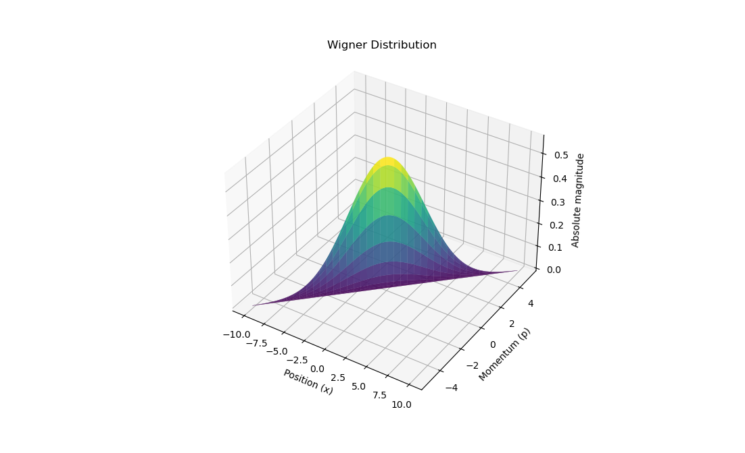
Coupled electron-nuclear dynamics
The real part of the wigner function represents some type of probability distribution and the imaginary part represents phase relation.
Wigner distribution gives negative probabilities also that’s why its called quasi-probability distribution.

Slide 3
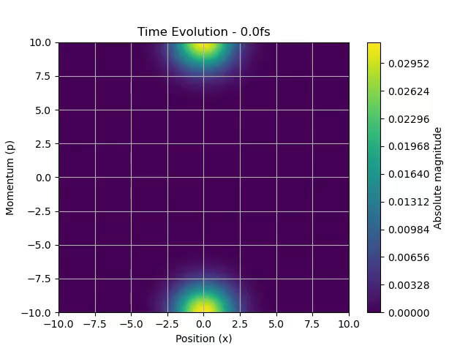
Wigner distribution
Here time evolution of wigner distribution of a gaussian function in a infinite potential well is shown.
Why it is showing distribution on top and in the bottom?

Slide 4
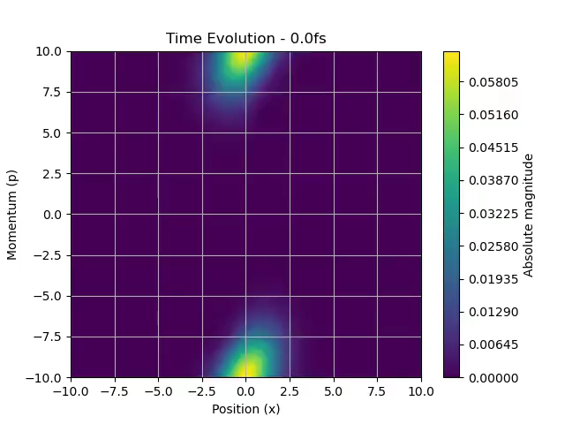
Wigner distribution in harmonic potential

